Slide 1

Synthetic Biology Open Language: Data Model version 3
Presenter: Gonzalo Vidal

Slide 2
Agenda
Introduction to SBOL
Hands on creation of a toggle switch circuit if time:
Demostration of SBOL for assembly planning
Demostration of SBOL for simulations

Slide 3
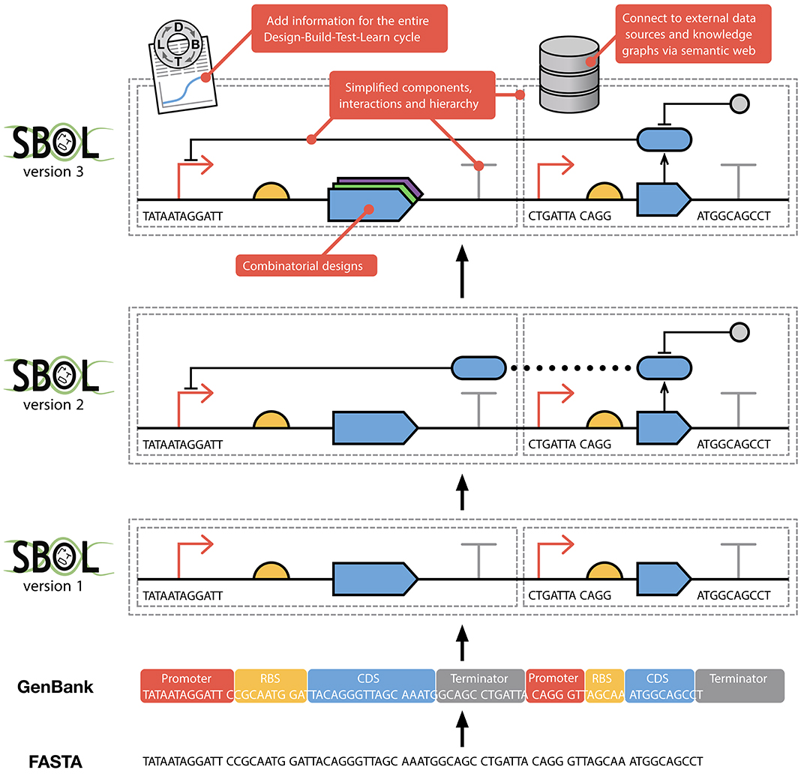
SBOL development
Fasta: Structural information.
GenBank: Structural and functional information.
SBOL: Standardized structural and functional information.

Slide 4
SBOL data model version 3
Core Design Classes
Complete Data Model

Slide 5
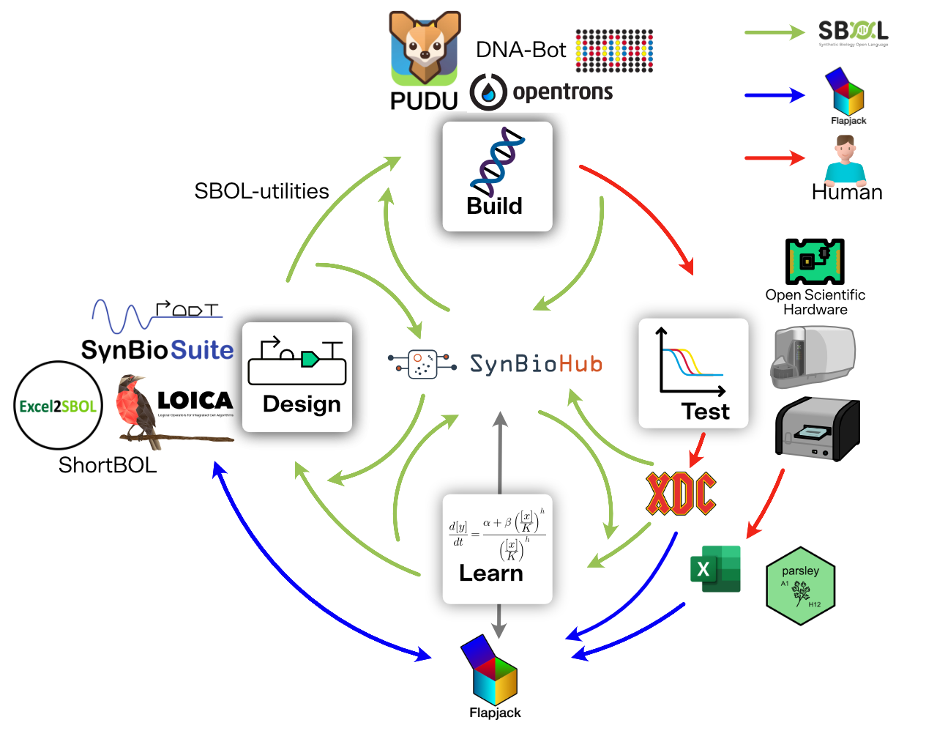
SBOL ecosystem
Interface between stages
Modular DBTL workflows
Collaboration in distributed DBTL workflows

Slide 6
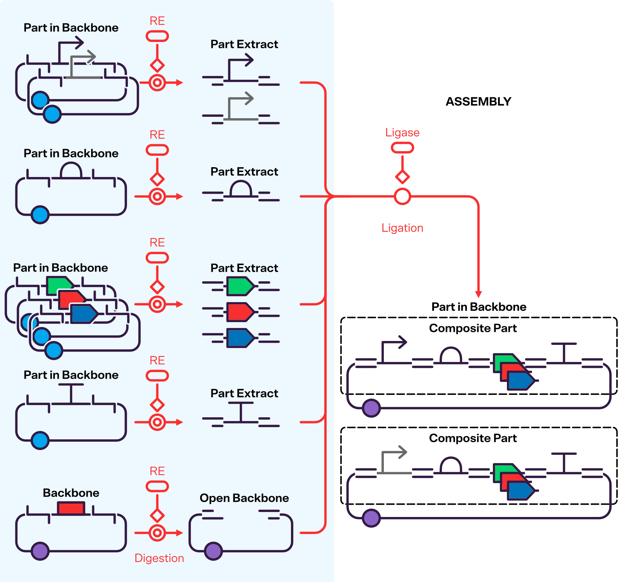
Wetlab example

Slide 7
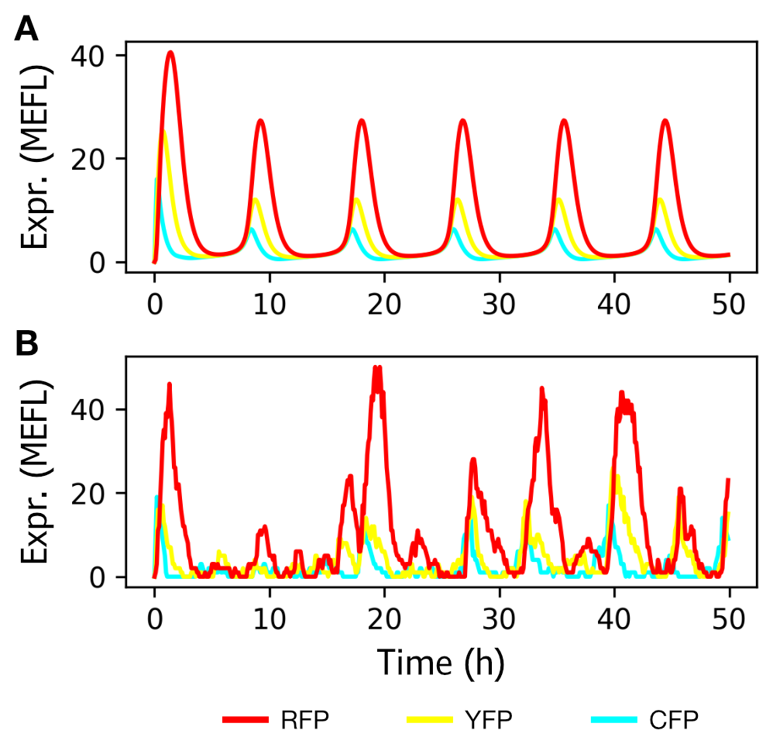
Drylab example

Slide 8










Aknowledgements

Slide 9
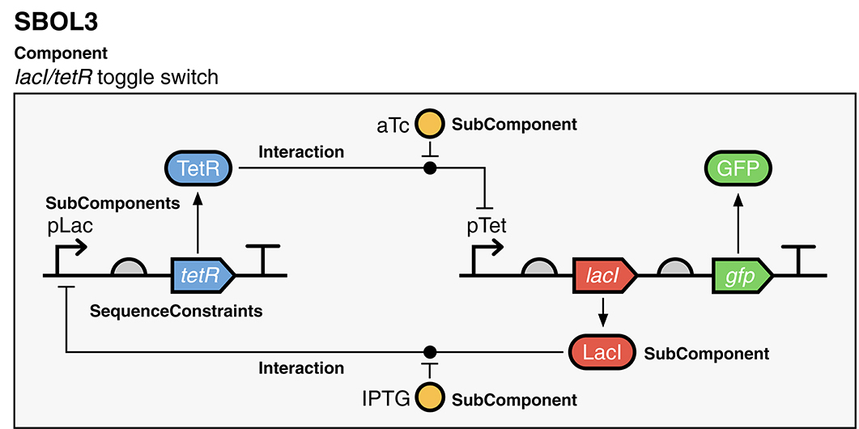
Example

Slide 10

Hands on exercise
https://tinyurl.com/IWBDA2024
Creating a toggle switch
Code:

Slide 11
Component: the root of every design
Nucleic acid sequence,
Amino acid sequence,
SMILES, etc…
Pointers to
numerical models
Parts/ SubComponents
Abstractions
Functional
interactions
Topology & identity
A component can be DNA, RNA, protein, a small molecule, a strain of cells, a media recipe, an experimental sample design, …

Slide 12
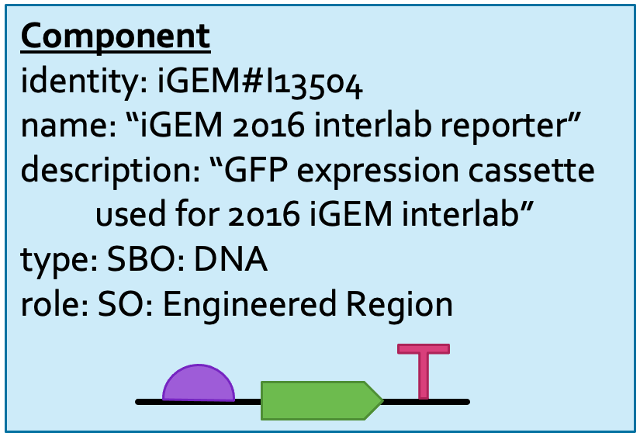
Example: GFP expression cassette

Slide 13
Features: Structural aspects of a component
Pointers to non-SBOL
(e.g., ChEBI, UniProt)
Reusable parts
Pointers inside
SubComponents
Local annotations
(e.g., cut sites, scars)
In-context parts
& placeholders

Slide 14
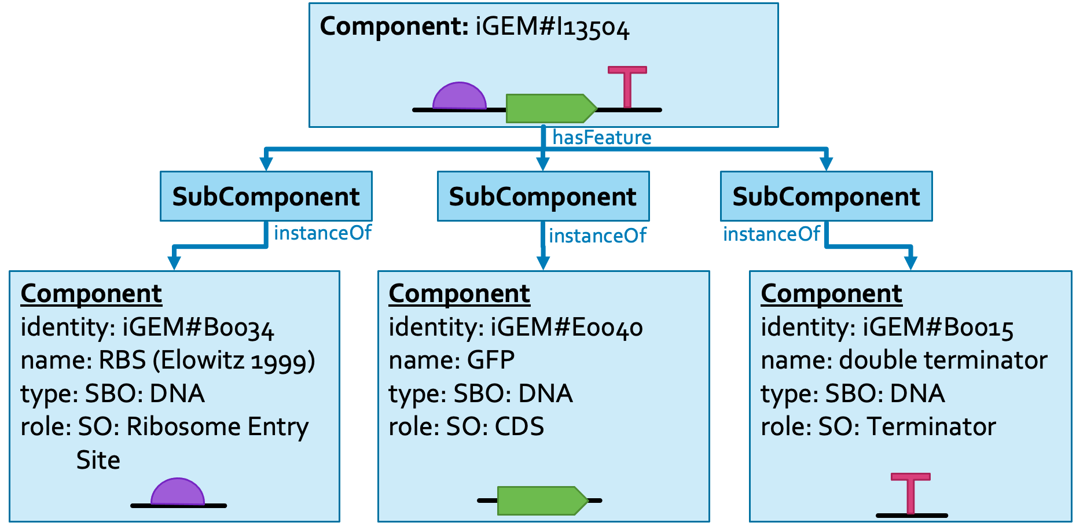
Example: expression cassette parts

Slide 15
Sequences & Locations
Forward or reverse complement
For introns, insertions,
origin-crossing
IUPAC NA, IUPAC AA,
SMILES, InChI, …
When just connecting
Component & Sequence
Between bases
(e.g., restriction site)
1 or more bases
(e.g., coding sequence)

Slide 16
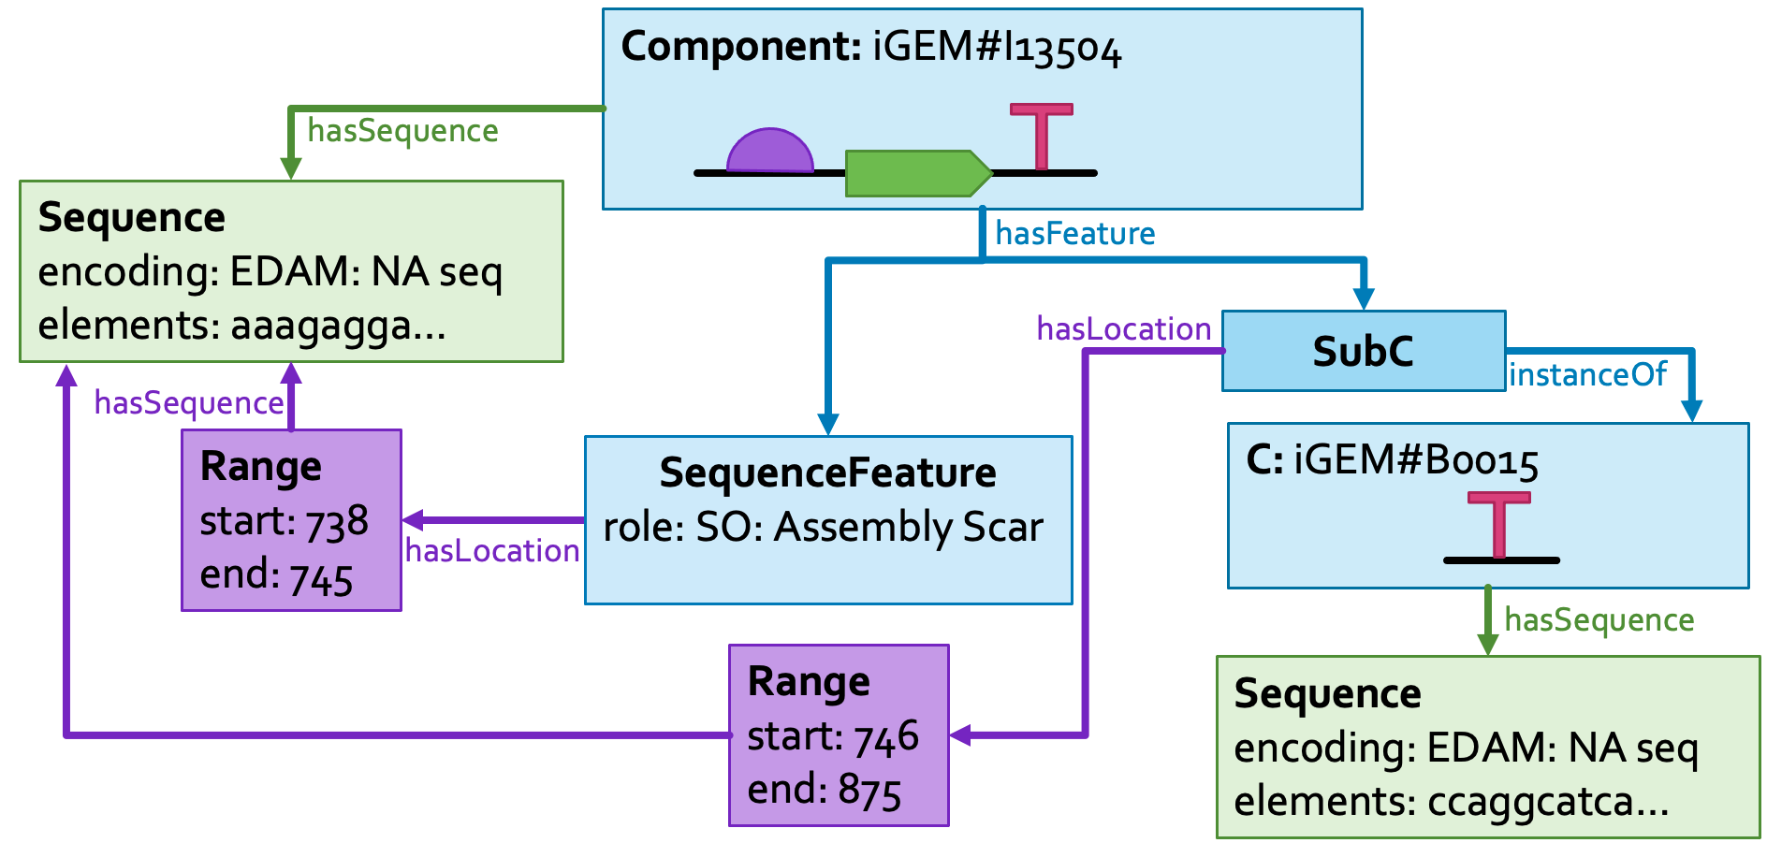
Example: Location of a SubComponent

Slide 17
Functional information: Interaction & Participation
e.g., genetic production,
biochemical reaction,
Inhibition, stimulation, …
Template, product,
reactant, inhibitor,
inhibited, …

Slide 18
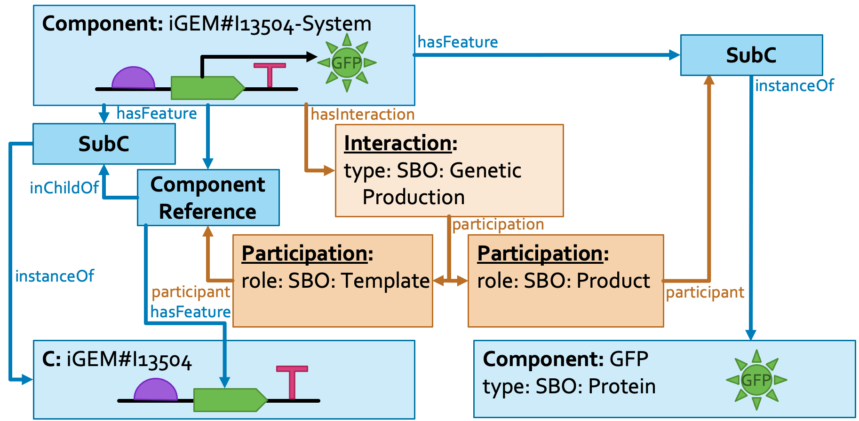
Example: GFP production from expression cassette

